Slide 1

Vehicle counting and speed estimation project
Made by group 4 cv

Slide 2
ABSTRACT Road Safety is an integral part of modern roads. This is why speed limits are given for a particular road depending on the quality of the road and the how prone the road is to accidents. Speed Cameras are set up at intervals of the road in order to catch speed-limit violators. Just like any other technology, speed cameras have progressed over the years. This project will focus on making a speed camera without sensors and only with Image processing of videos

Slide 3
Introduction
PROBLEM STATEMENT
The objective of this project is to create a traffic radar using Image Processing in Python by using OpenCV and counting the cars
When it comes to tracking the speed of vehicles on a segment of road, the vital steps of this projects is:
• Vehicle detection
• Vehicle counting
• Speed estimation

Slide 4
Vehicle detection
vehicle detection aims to provide information assisting vehicle counting, vehicle speed measurement, identification of traffic accidents, traffic flow prediction, etc.
As the background of the vehicles is stationary (as the speed camera is stationary) image subtraction is used to detect moving vehicle.
Vehicle Detection Block Diagram
Specify region interest
Mask ROI
Identify contour(with area threshold
Display video
Save dimension of contour
Update tracker

Slide 5
Vehicle counting
Intelligent vehicle counting plays an important role in the transportation systems of smart cities. Computationally efficient and reliable deep learning algorithms can classify the type of vehicle and count them in real-time using the video of conventional surveillance cameras.
Vehicle counting is a key strategy of traffic analytics and can be used on highway and urban roads under different weather and traffic conditions.

Slide 6
Speed estimation
This would be done by using time taken to cover a segment of road taking into consideration the accuracy (which is mostly determined by frame rate).
The road shall be divided to multiple segments to estimate speed.

Slide 7
How could we use it in real life ?
1-Identify congested roads and try to reduce it
2-Imposing fines on those who exceed the specified speed
3-Determining the number of specific vehicles that can be entered in certain places

Slide 8
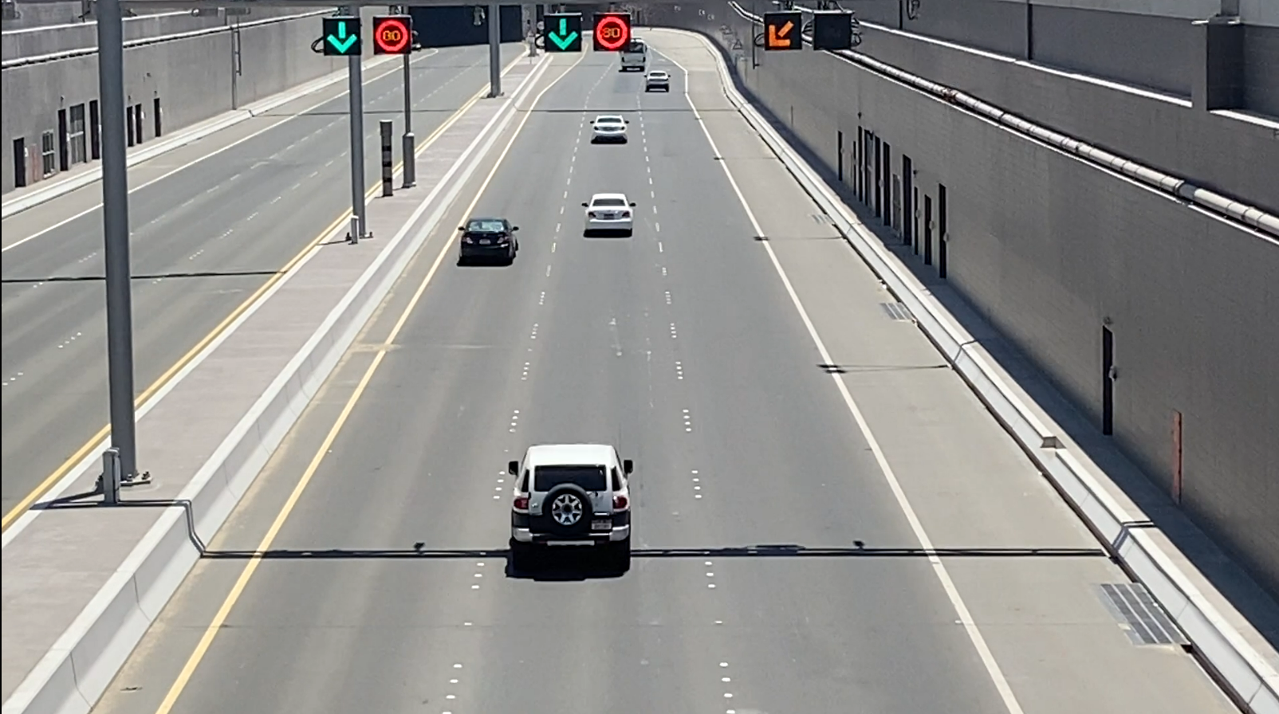
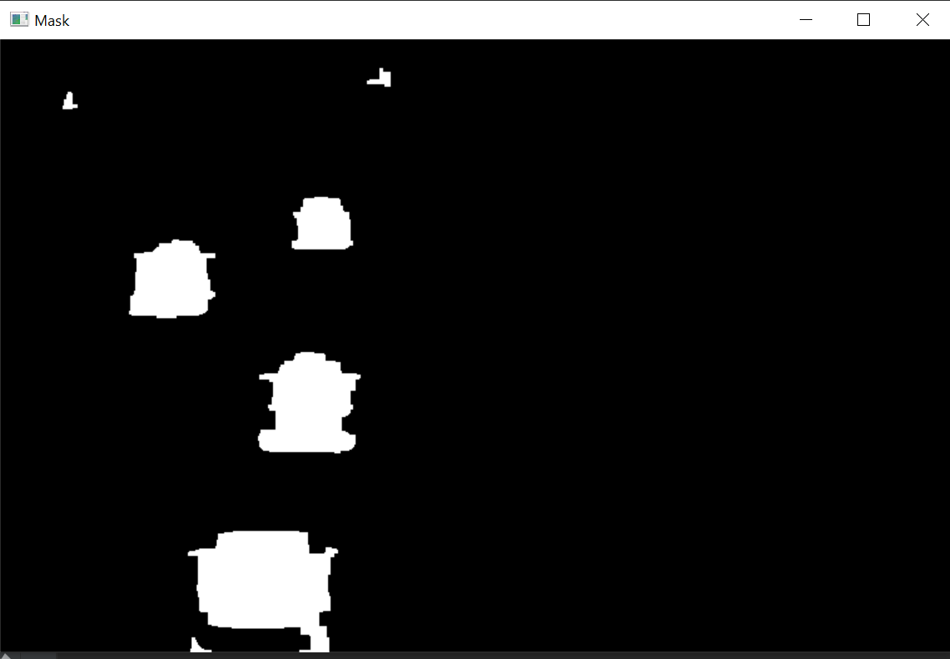
Project model – object tracking
DETECT CONTOURS
OBJECT TRACKER
ELIMINATE
BASED ON AREA

Slide 9


SPEED ESTIMATION
CAPTURE IMAGE and
SAVE SPEED
END TIMER s2[ID]
START
TIMER
s1[ID]

Slide 10
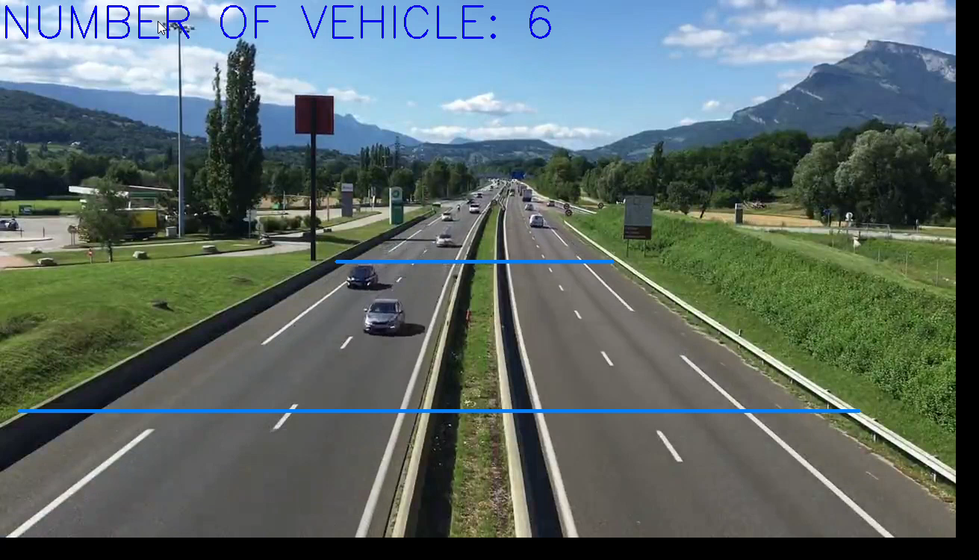

Slide 11
References
Detection of Vehicle Position and Speed using Camera Calibration and Image Projection Methods
https://www.sciencedirect.com/science/article/pii/S187705091931083X
Vehicle speed measurement model for video-based systems
https://www.sciencedirect.com/science/article/pii/S0045790618317774
An Efficient Approach for Detection and SpeedEstimation of Moving Vehicles
https://www.sciencedirect.com/science/article/pii/S1877050916311103

Slide 12
Thank You

